Slide 1

Predicting Employee Attrition Using Random Forest
Guided By:
Pradeepthi Mam, Senior AI Developer

Slide 2





Team
Sri Harshitha
Chandana
Sowmya
Sai Revanth
Faiyazuddin

Slide 3
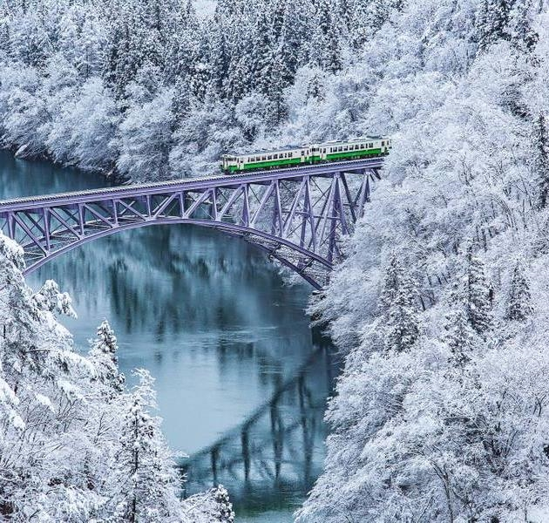
Agenda
Introduction
Problem Statement
procedure
Solution
Output
Summary

Slide 4
Introduction
Employee Attrition is the gradual reduction in staff numbers that occurs as employees retire or resign and are not replaced. Employee attrition can be costly for businesses. The company loses employee productivity, and employee knowledge.
“Turnover / Churn” and “Attrition” are human resource terms that is often times confused. Employee turnover and attrition both occur when an employee leaves the company. Turnover, however, is from several different actions such as discharge, termination, resignation or abandonment. Attrition occurs when an employee retires or when the employer eliminates the position. The big difference between the two is that when turnover occurs, the company seeks someone to replace the employee. But in the case of attrition, the employer leaves that vacancy unfilled or eliminates that job role.

Slide 5
Problem Statement: Predicting Employee Attrition Using Random Forest
The main aim and problem of the project is to predict the employee attrition using Random Forest Classifier.

Slide 6
Procedure
Collect the Dataset.
01
Built the model by training and testing the dataset by using Random Forest Classifier.
02
Integrate the model built with flask in python file.
03
Create the HTML and CSS for developing the webpage.
04
Display the output which predicts the employee attrition for the data entered into the form of a webpage.
05

Slide 7
Solution
There are some basic steps to be followed in machine learning algorithm; here we are using random forest as machine learning algorithm.
Data preprocessing: Here we load the dataset and verify if any null values found in the dataset or not. Data analysis: By plotting the graphs from the dataset where are analyzing some criteria. So that which can easily predict the employee attrition by 0 and 1 values which are previously converted to Boolean.

Slide 8
Model training: the dataset into training and test sets using 70/30 split; 70% of data will be used to train the model and the rest 30% to test the accuracy of the model. After partitioning and balancing, our data is finally ready to be the input of the machine learning models. We will train with Random Forest algorithm. Model validation: Using the random forest classifier we predict the accuracy and we will compare our model outputs with the real world observations i.e. test data.
Predictions of the model: Predictions which are predicted from our value are stored in model.pkl file which is sent to python for predicting whenever data is entered from html, the value gets predicted in the webpage.

Slide 9
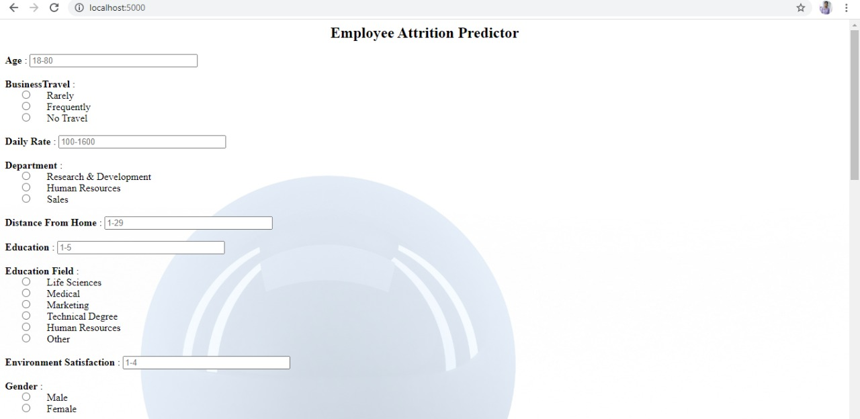
Output Employee Attrition NO: Chance of staying in the company

Slide 10
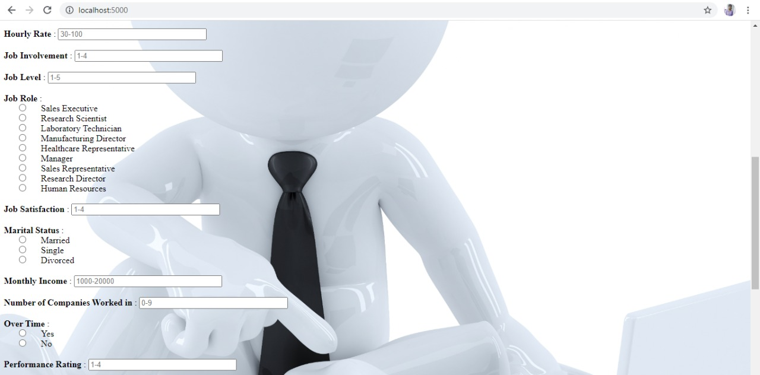

Slide 11
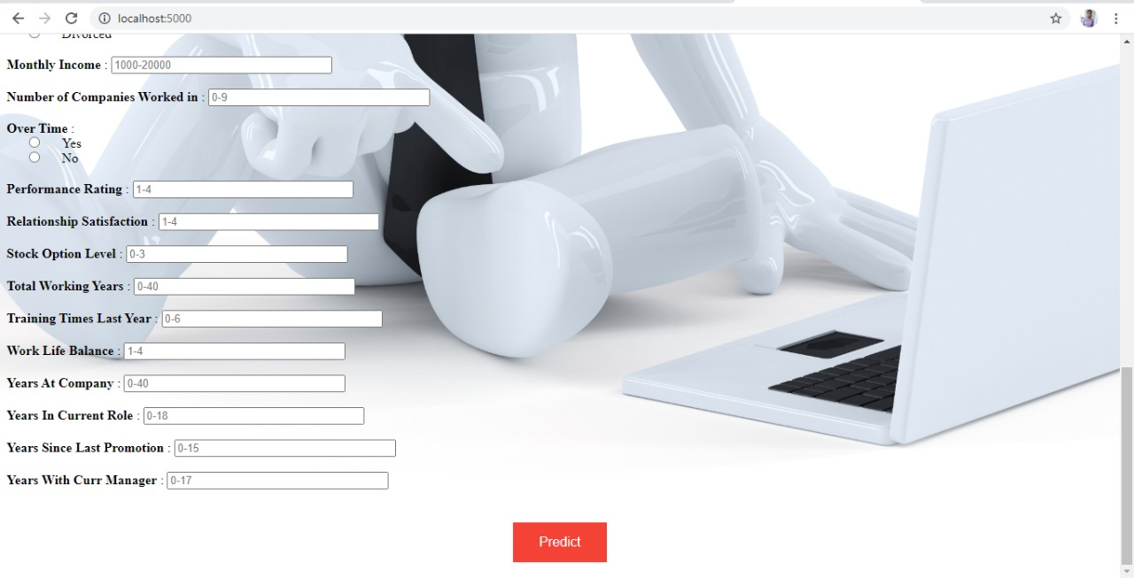

Slide 12
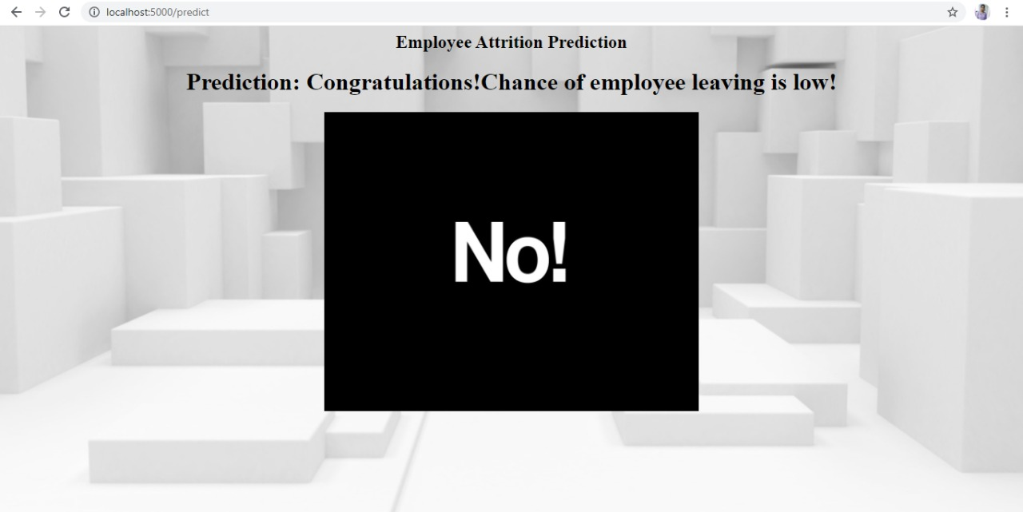

Slide 13
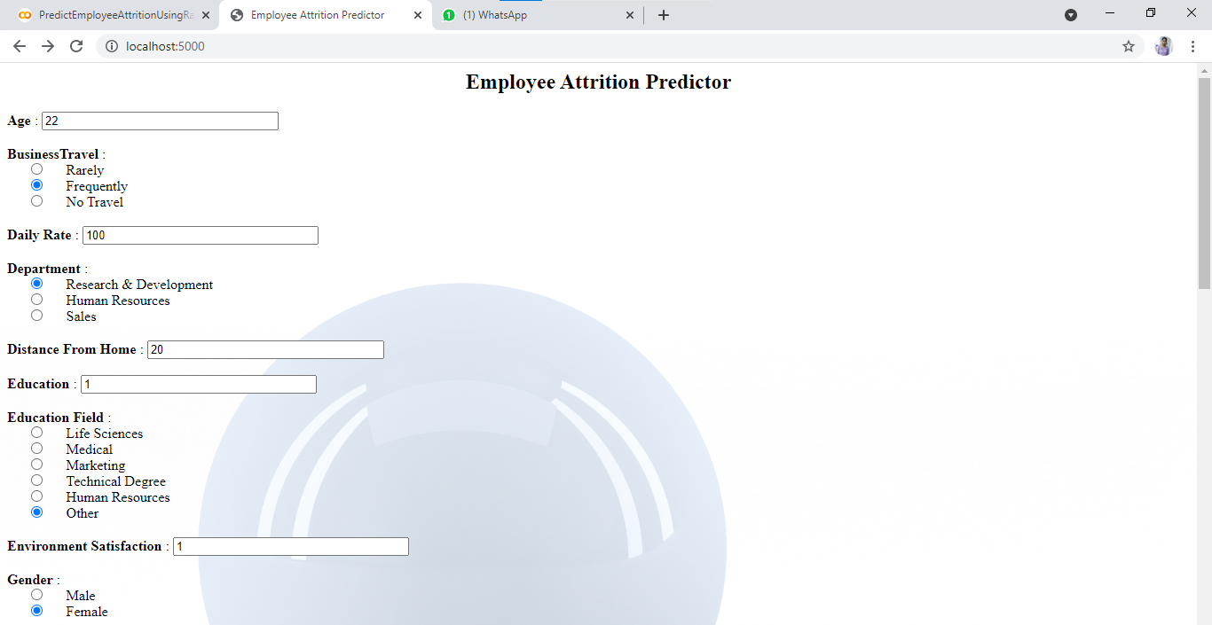
Employee Attrition YES: Chance of Leaving the company

Slide 14
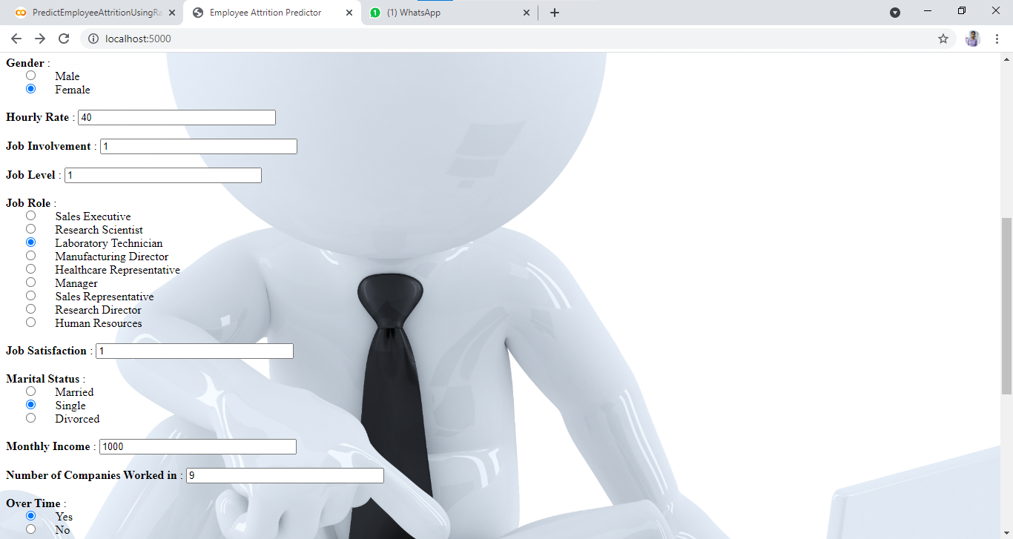

Slide 15
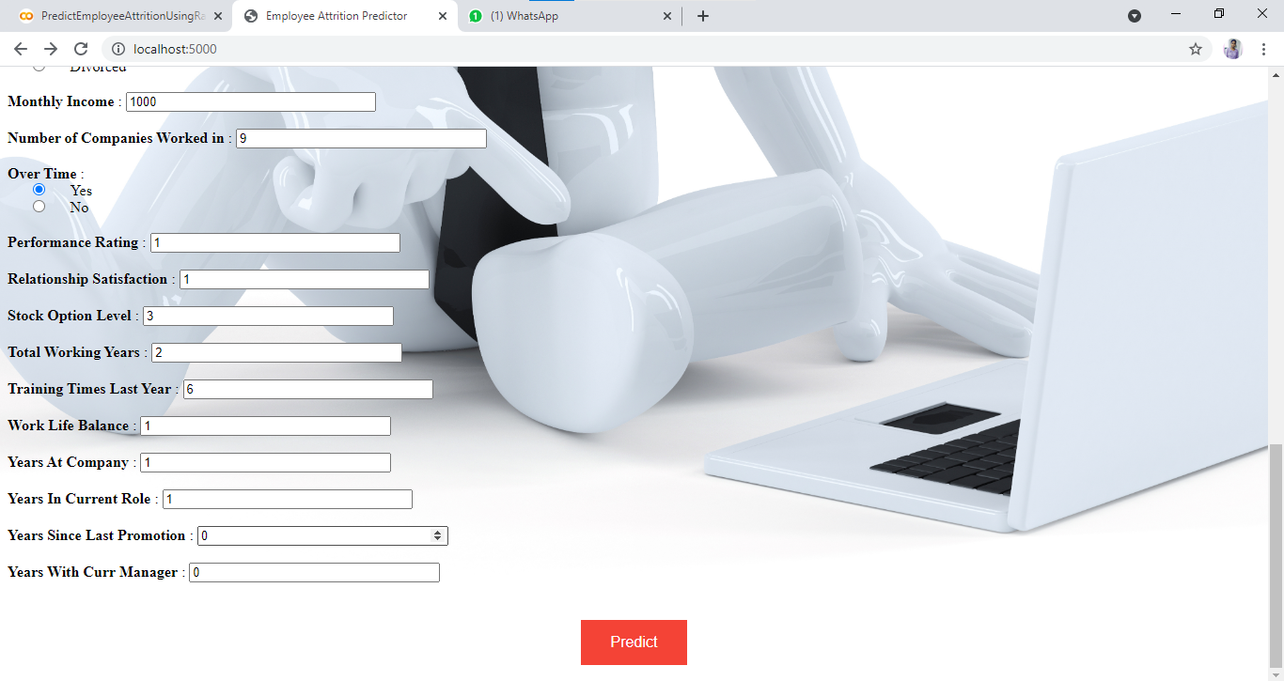

Slide 16
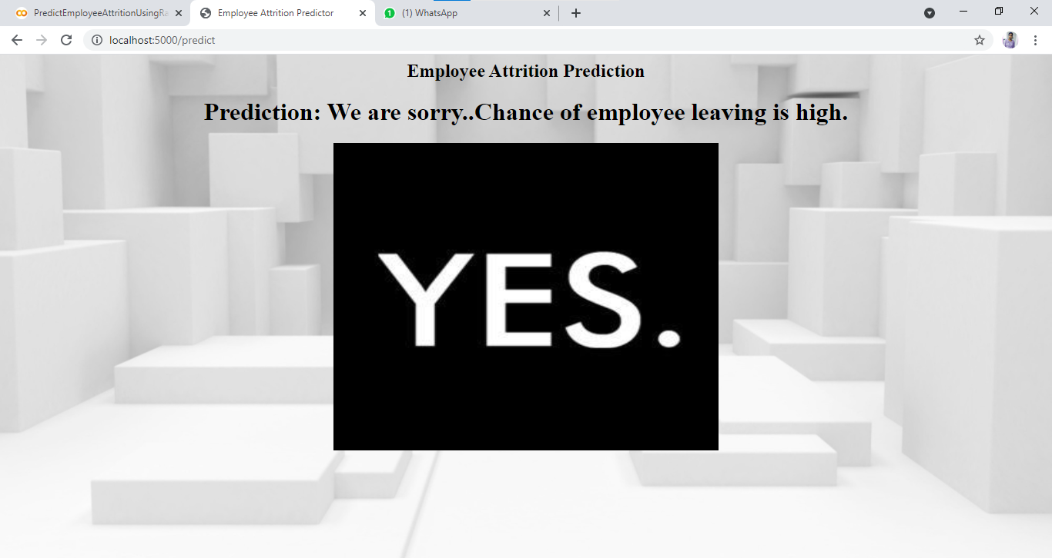

Slide 17
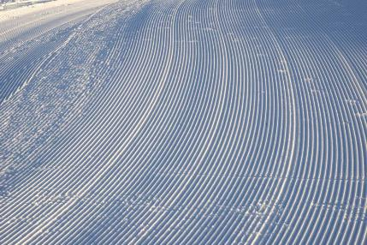
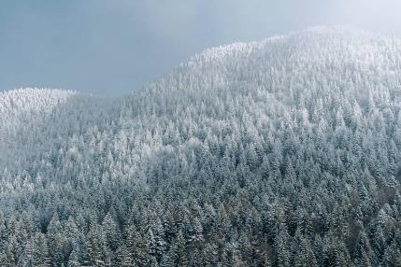

Summary
We have a problem that employee attrition so to overcome this problem we are using Random Forest classifier to predict employee attrition. First we collect the data and build the model by training and testing using Random Forest classifier. Next, we are using Flask application to integrate the Model. We design a webpage by using HTML and CSS. Finally we see our output in the browser which predicts employee attrition.

Slide 18
Thank you…

